Slide 1
TIES4910: Deep Learning for Cognitive Computing
Rui YAN
Faculty of Information Technology
University of Jyväskylä

Slide 2









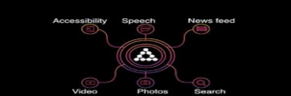




Cognitive Services
https://www.microsoft.com/cognitive-services
https://cloud.microsoft.com/
http://www.ibm.com/watson/
https://staging.www.projectoxford.ai/
https://www.ibm.com/cloud-computing/bluemix/
VS.
FBLearner Flow
https://code.facebook.com/posts/1072626246134461/introducing-fblearner-flow-facebook-s-ai-backbone/
https://aws.amazon.com/machine-learning/
https://deepmind.com/
https://cloud.google.com/

Slide 3
1. IBM Watson: Natural Language Understanding
Address: https://natural-language-understanding-demo.ng.bluemix.net/
Natural Language Understanding is a collection of APIs that offer text analysis through natural language processing to help you understand its concepts, entities, keywords, sentiment, and more. Provide plain text, HTML, or a public URL, and Natural Language Understanding returns results for the features you specify. This set of APIs can analyze text Additionally, you can create a custom model for some APIs to get specific results that are tailored to your domain. This system is for demonstration purposes only and is not intended to process Personal Data.

Slide 4
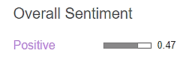


1. IBM Watson: Natural Language Understanding
The university experience must tell women that their brain power is valued, and not just that, but that they belong among the leadership of the university itself. And so importantly, right now, the experience must make it clear that the safety of women, minorities, and anyone who may be vulnerable is a right and not a privilege. A right that will be respected by a community that believes and supports survivors. And that recognizes that when one person's safety is violated, everyone feels that their own safety is violated. A university should be a place of refuge that takes action against all forms of violence. That's why we believe that students should leave university believing in, striving for, and expecting societies of true equality. Societies of true equality in every sense, and that universities have the power to be a vital catalyst for that change.
Emma Watson's 2016 UN Speech on Gender Equality:

Slide 5
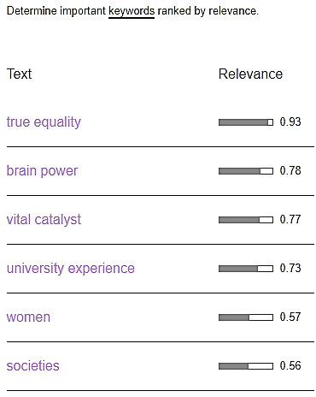
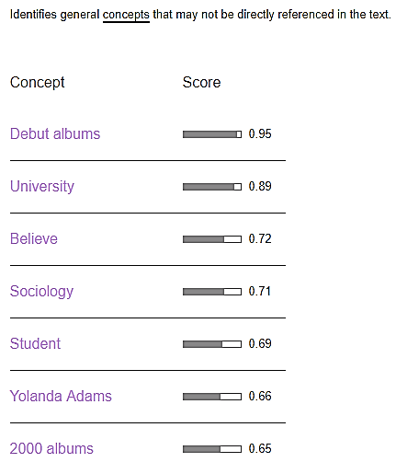
1. IBM Watson: Natural Language Understanding

Slide 6
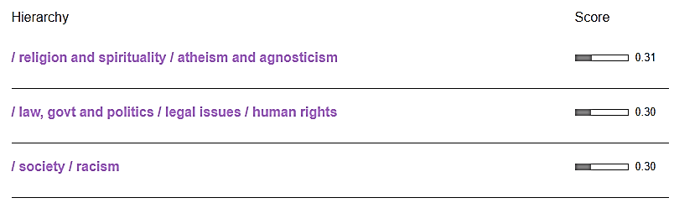
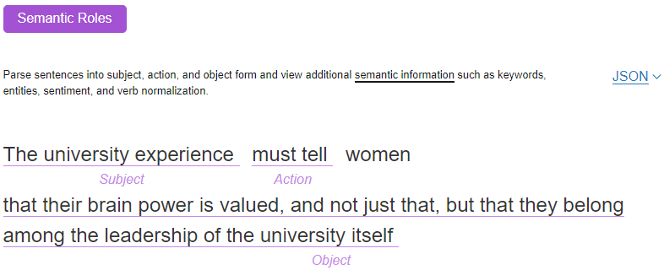
1. IBM Watson: Natural Language Understanding

Slide 7
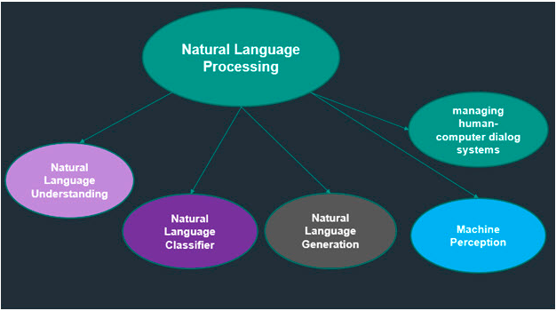
2. IBM Watson: Natural Language Classifier
Address: https://natural-language-classifier-demo.ng.bluemix.net/
Natural Language Classifier is a field of computer science, artificial intelligence (AI) and computational linguistics concerned with the interactions between computers and human (natural) languages as depicted by the following figure.

Slide 8
2. IBM Watson: Natural Language Classifier
Typical cases:
Classify email as SPAM or No-SPAM based on the subject line and email body.
Create question and answer (Q&A) applications for a particular industry or domain.
Classify news content following some specific classification such as business, entertainment, politics, sports, and so on.
Categorize volumes of written content.
Categorize music albums following some criteria such as genre, singer, and so on.
Combine the Watson Natural Language Classifier service with the Watson Conversation service if you want your application to engage in a conversation with user.
Classify frequently asked questions (FAQs)

Slide 9
2. IBM Watson: Natural Language Classifier
Ask: Is it hot outside?
Output: Natural Language Classifier is 100% confident that the question submitted is talking about temperature.
Ask: Will there be a storm today?
Output: Natural Language Classifier is 95% confident that the question submitted is talking about conditions.
Ask: Should I prepare for sleet?
Output: Natural Language Classifier is 94% confident that the question submitted is talking about conditions.

Slide 10
3. IBM Watson: Personality Insights
Gain insight into how and why people think, act, and feel the way they do. This service applies linguistic analytics and personality theory to infer attributes from a person's unstructured text.
You need text written by the person whose personality you're interested in. It should contain words about every day experiences, thoughts, and responses.
You can play with the demo with as little as 100 words, but for a more accurate analysis, you need more words.

Slide 11
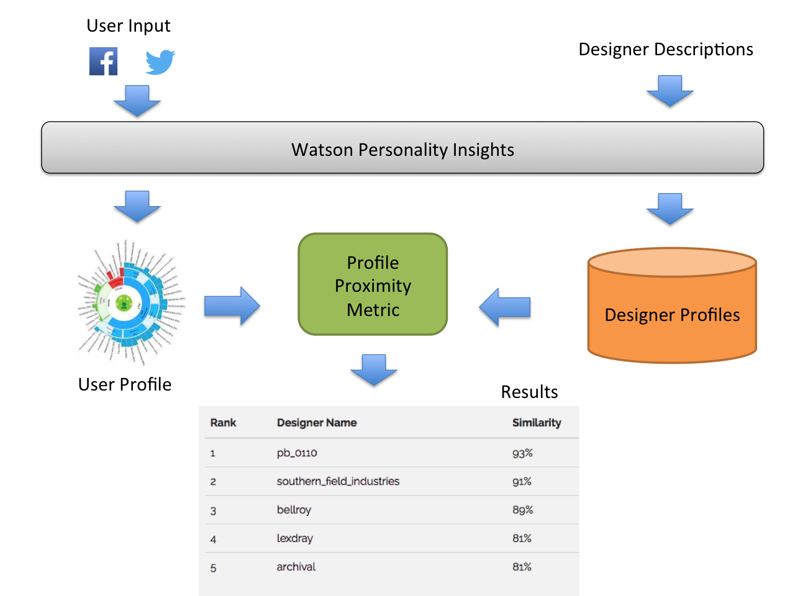
3. IBM Watson: Personality Insights

Slide 12
3. IBM Watson: Personality Insights
We analyzed Oprah’s Tweets and Replies. Oprah Winfrey (born Orpah Gail Winfrey; January 29, 1954) is an American media executive, actress, talk show host, television producer and philanthropist. She is best known for her talk show The Oprah Winfrey Show, which was the highest-rated television program of its kind in history and was nationally syndicated from 1986 to 2011 in Chicago.

Slide 13
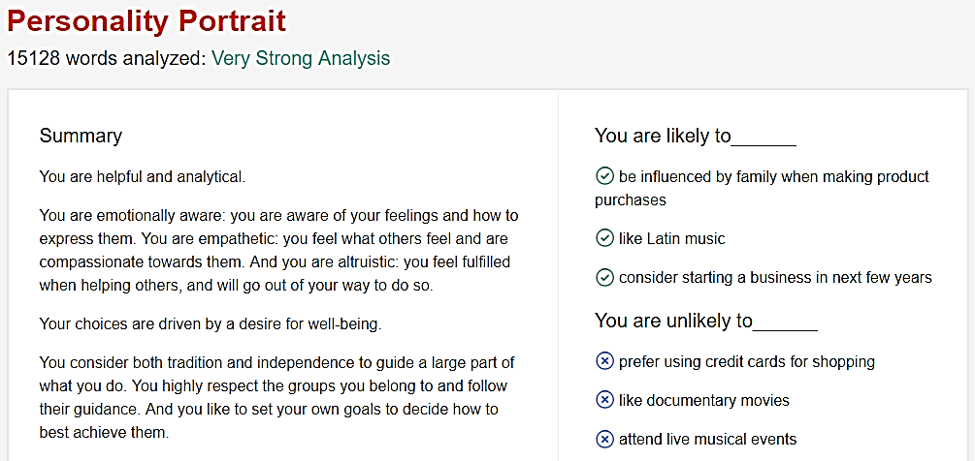
3. IBM Watson: Personality Insights

Slide 14
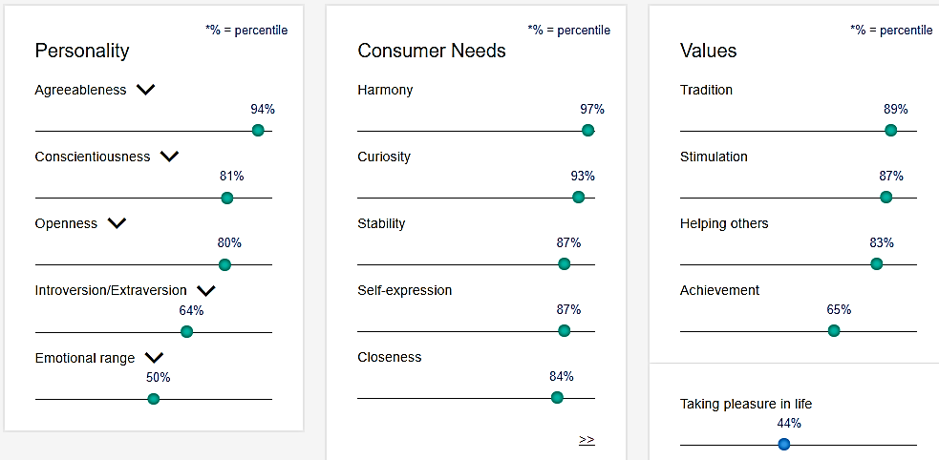
3. IBM Watson: Personality Insights

Slide 15
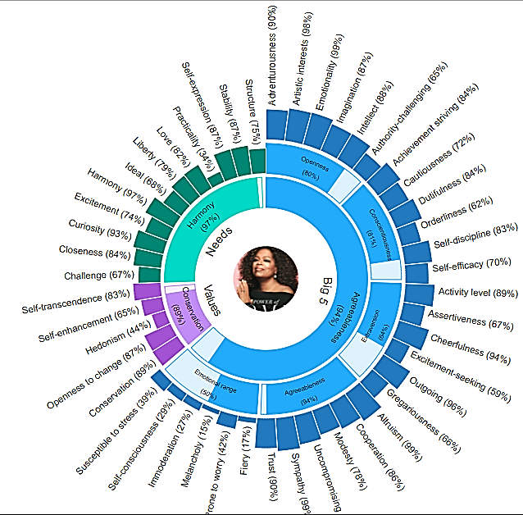

Slide 16
4. IBM Watson: Text to Speech
Address: https://text-to-speech-demo.ng.bluemix.net/
The Text to Speech service understands text and natural language to generate synthesized audio output complete with appropriate cadence and intonation. It is available in 13 voices across 7 languages. Select voices now offer Expressive Synthesis and Voice Transformation features.

Slide 17

4. IBM Watson: Text to Speech
The university experience must tell women that their brain power is valued, and not just that, but that they belong among the leadership of the university itself. And so importantly, right now, the experience must make it clear that the safety of women, minorities, and anyone who may be vulnerable is a right and not a privilege. A right that will be respected by a community that believes and supports survivors. And that recognizes that when one person's safety is violated, everyone feels that their own safety is violated. A university should be a place of refuge that takes action against all forms of violence. That's why we believe that students should leave university believing in, striving for, and expecting societies of true equality. Societies of true equality in every sense, and that universities have the power to be a vital catalyst for that change.
English with a German accent
American English

Slide 18
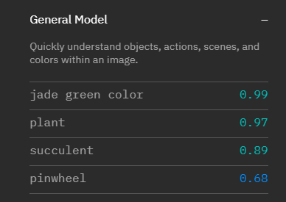

5. IBM Watson: Visual Recognition
Address: https://www.ibm.com/watson/services/visual-recognition/demo/#demo
Visual Recognition understands the contents of images. Analyze images for scenes, objects, faces, colors, food, text, explicit content and other subjects that can give you insights into your visual content.

Slide 19

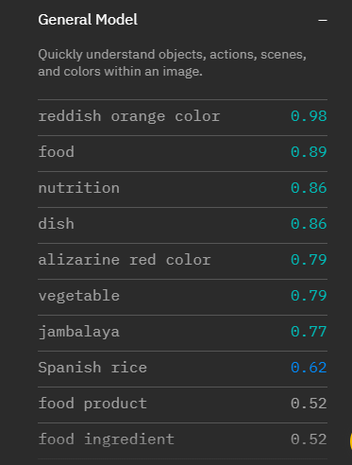
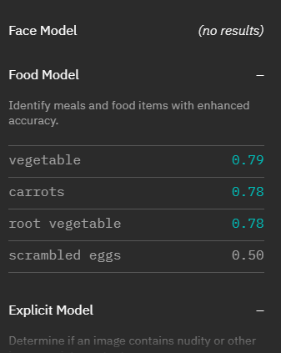
5. IBM Watson: Visual Recognition
Recipe of Scrambled Eggs with Tomatoes

Slide 20

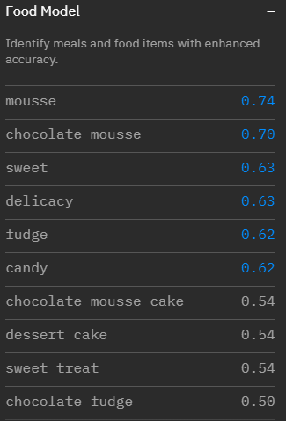
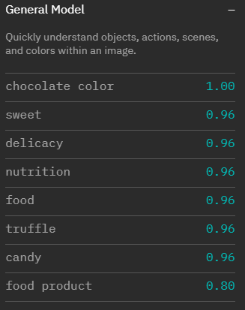
5. IBM Watson: Visual Recognition

Slide 21
6. Microsoft Cognitive Services: Emotion API
Address: https://www.microsoft.com/cognitive-services/en-us/emotion-api
Recognize emotions in images:
The Emotion API takes a facial expression in an image as an input, and returns the confidence across a set of emotions for each face in the image, as well as bounding box for the face, using the Face API. The emotions detected are anger, contempt, disgust, fear, happiness, neutral, sadness, and surprise.
Recognize emotions in video:
You can use the Emotion API to track how a person or a crowd responds to your content over time. Recognize emotions in video by extracting frames of a video and then sending those frames to the API.

Slide 22
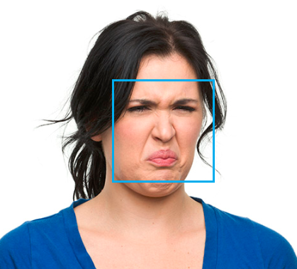
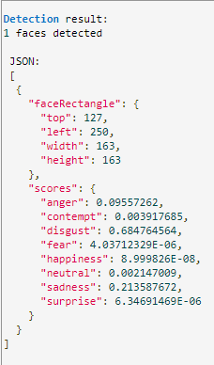
6. Microsoft Cognitive Services: Emotion API
I thought this recognition is accurate.

Slide 23
7. Microsoft Cognitive Services: Face API
Address: https://www.microsoft.com/cognitive-services/en-us/face-api
Face verification: Check the likelihood that two faces belong to the same person. The API will return a confidence score about how likely it is that the two faces belong to one person.
Face detection: Detect one or more human faces in an image and get back facial features containing Age, Emotion, Gender, Pose, Smile, and Facial Hair along with 27 landmarks for each face in the image.
Emotion recognition: The Face API now integrates emotion recognition, returning the confidence across a set of emotions for each face in the image such as anger, contempt, disgust, fear, happiness, neutral, sadness, and surprise.
Face identification: Face API enables you to search, identify, and match faces in your private repository of up to 1 million people.
Similar face search: Easily find similar-looking faces. Given a collection of faces and a new face as a query, this API will return a collection of similar faces.
Face grouping: Organize many unidentified faces together into groups, based on their visual similarity.
More powerful API

Slide 24



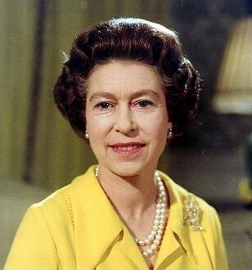
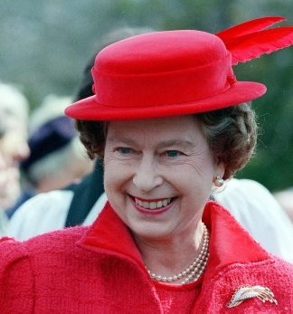
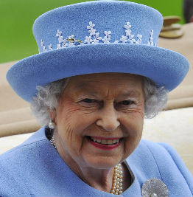
7. Microsoft Cognitive Services: Face API
0.52757
0.67141
0.42899
0.39593
Confidence is 0.33336
0.68905
0.71208
Confidence < 0.5: The two faces belong to different people
Confidence > 0.5: The two faces belong to same people

Slide 25
8. Microsoft Cognitive Services: Computer Vision API
Address: https://www.microsoft.com/cognitive-services/en-us/computer-vision-api
Function: Extract rich information from images to categorize and process visual data and perform machine-assisted moderation of images to help curate your services.
Analyze an image: Returns information about visual content found in an image.
Read text in images:
Read handwritten text from images
Recognize celebrities and landmarks
Analyze video in near real-time
Generate a thumbnail

Slide 26
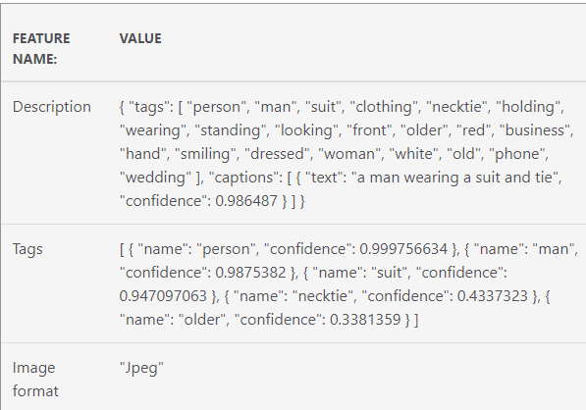
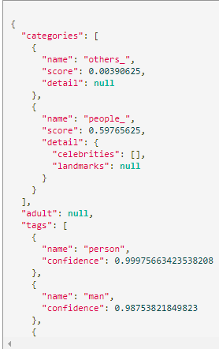


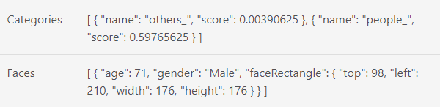
8. Microsoft Cognitive Services: Computer Vision API
It can't recognize Trump

Slide 27
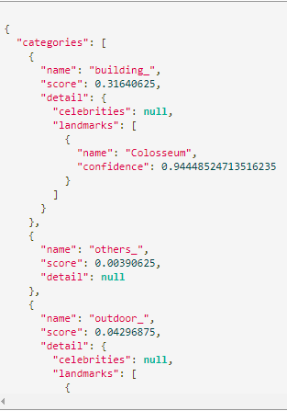
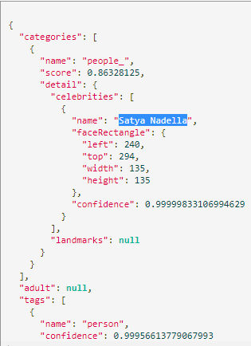

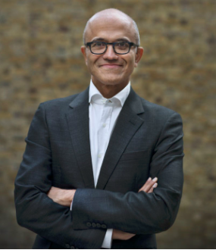
8. Microsoft Cognitive Services: Computer Vision API
But It does know the Colosseum and Satya Nadella

Slide 28
9. Microsoft Cognitive Services: Speech API
Address: https://www.microsoft.com/cognitive-services/en-us/speech-api
Function: Convert audio to text, understand intent, and convert text back to speech for natural responsiveness.
Support: 34 languages, multiple dialects and accents.
Compared to Cognitive Services provided by IBM Watson (Text-to-Speech), this one seems to be more powerful.

Slide 29
9. Microsoft Cognitive Services: Speech API
The university experience must tell women that their brain power is valued, and not just that, but that they belong among the leadership of the university itself. And so importantly, right now, the experience must make it clear that the safety of women, minorities, and anyone who may be vulnerable is a right and not a privilege. A right that will be respected by a community that believes and supports survivors. And that recognizes that when one person's safety is violated, everyone feels that their own safety is violated. A university should be a place of refuge that takes action against all forms of violence. That's why we believe that students should leave university believing in, striving for, and expecting societies of true equality. Societies of true equality in every sense, and that universities have the power to be a vital catalyst for that change.
English-CA
English-IN

Slide 30
10. Microsoft Cognitive Services: Text Analytics API
Address: https://www.microsoft.com/cognitive-services/en-us/text-analytics-api
Function: Detect sentiment, key phrases, and language from your text
Sentiment Analysis: Find out what customers think of your brand or topic by analyzing raw text for clues about positive or negative sentiment.
Key Phrase Extraction: Automatically extract key phrases to quickly identify the main points.
Language Detection: Support 120 languages
Entity Recognition: Identify and categorize entities in your text as people, places, organizations, date/time, quantities, percentages, currencies, and more.

Slide 31

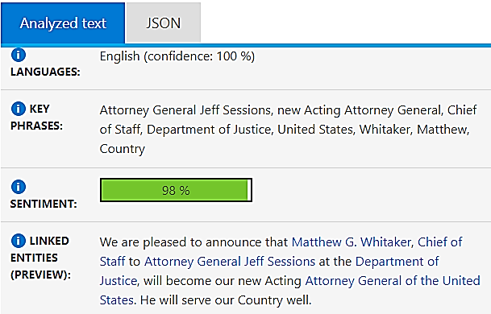
10. Microsoft Cognitive Services: Text Analytics API

Slide 32
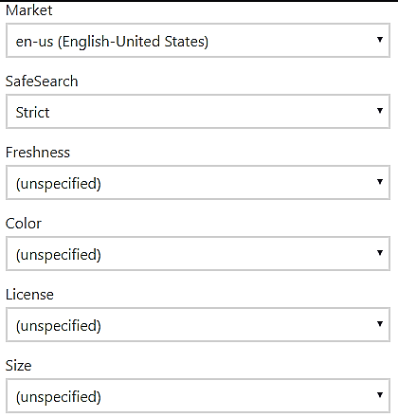
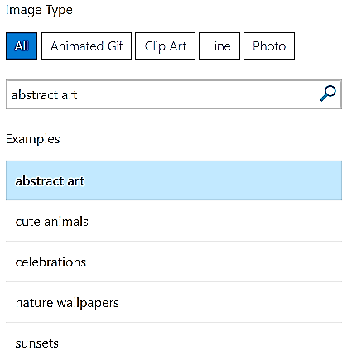
11. Microsoft Cognitive Services: Image Search API
Address: https://www.microsoft.com/cognitive-services/en-us/bing-image-search-api
Function: Add a variety of image search options to your app or website, from trending images to detailed insights.

Slide 33
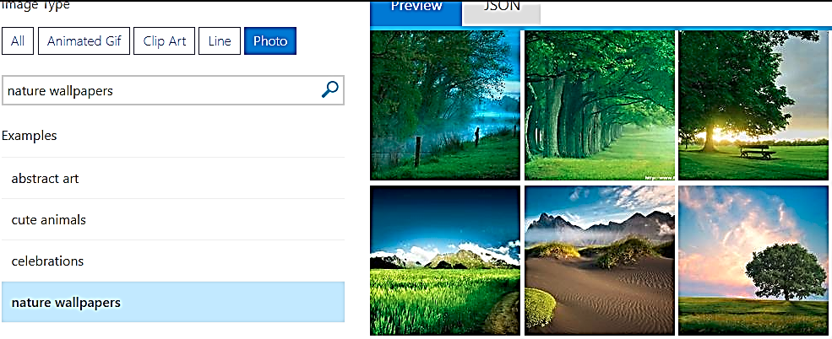

11. Microsoft Cognitive Services: Image Search API

Slide 34
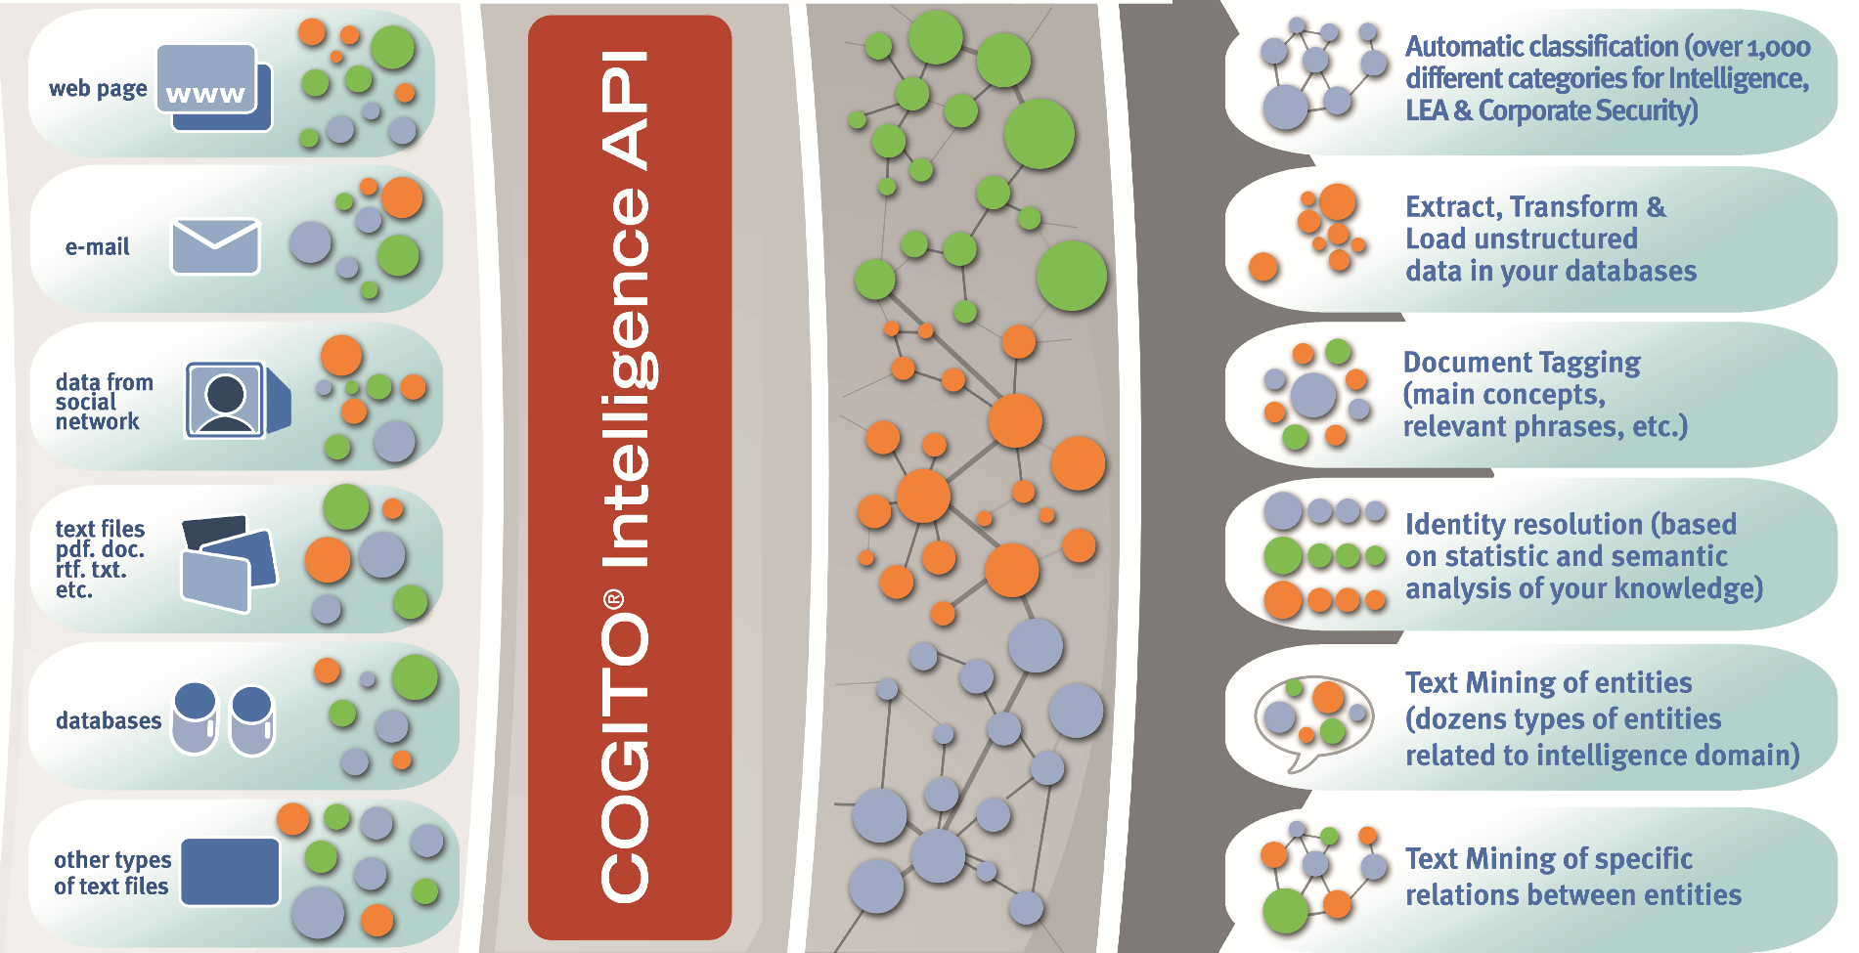
12. COGITO Cognitive Services: Intelligence API
Address: http://www.intelligenceapi.com/demo/

Slide 35
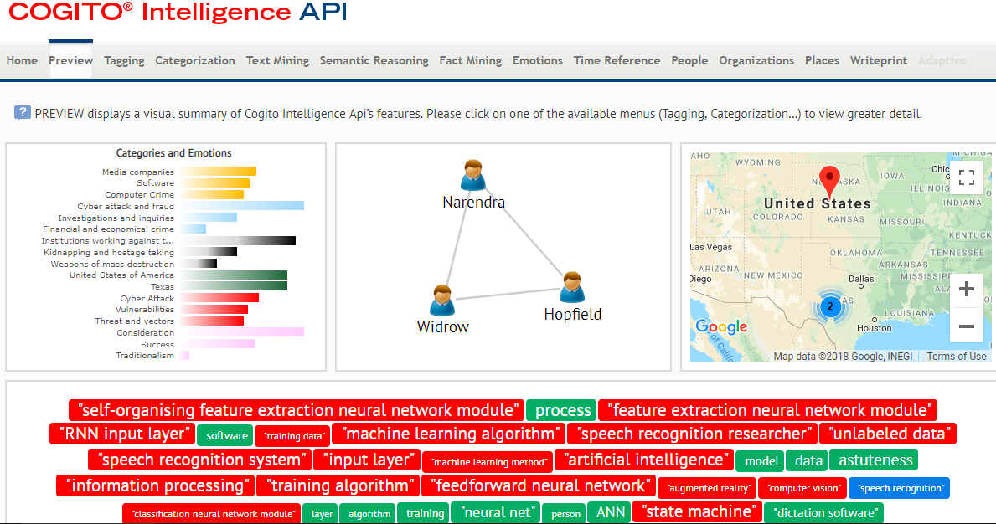
12. COGITO Cognitive Services: Intelligence API
Analyze the webpage: https://en.wikipedia.org/wiki/Deep_learning

Slide 36
13. Google Cognitive Services: Cloud Vision API
Address: https://cloud.google.com/vision
Function: Add a variety of image search options to your app or website, from trending images to detailed insights.
Insight from your images: Easily detect broad sets of objects in your images, from flowers, animals, or transportation to thousands of other object categories commonly found within images.
Extract text
Power of the web: Vision API uses the power of Google Image Search to find topical entities like celebrities, logos, or news events.
Content moderation: Powered by Google Safe Search, easily moderate content and detect inappropriate content from your crowd-sourced images.

Slide 37
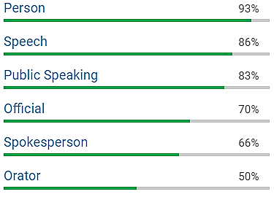
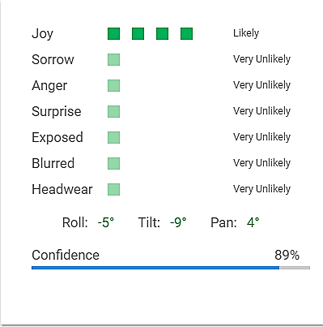
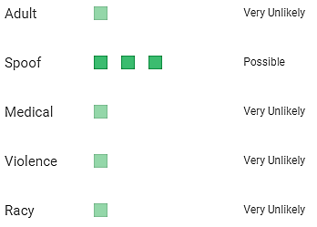
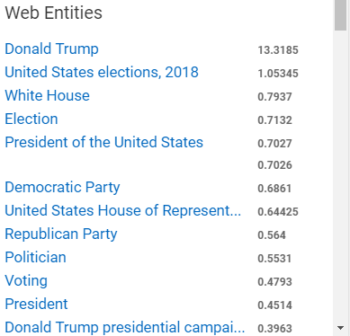
13. Google Cognitive Services: Cloud Vision API
Labels
Safe Search
Face
Powerful

Slide 38
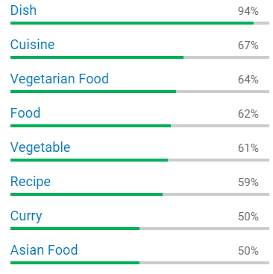
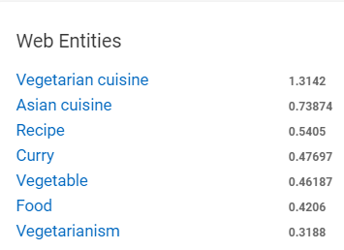
13. Google Cognitive Services: Cloud Vision API
Recipe of Scrambled Eggs with Tomatoes

Slide 39
14. Google Cognitive Services: Cloud Translation API
Address: https://cloud.google.com/translate/
Function: Dynamically translate between languages.
Translate many languages: Translation API supports more than one hundred different languages.
Language detection: Sometimes you don’t know your source text language in advance.
Simple integration: Translation API is an easy-to-use Google REST API.
Highly scalable: Translation API can seamlessly scale with almost any volume.
Simple, affordable pricing: Translation API charges on a per-character basis, even if the character is multiple bytes.
Insight from your images: Easily detect broad sets of objects in your images, from flowers, animals, or transportation to thousands of other object categories commonly found within images.
Extract text
Power of the web: Vision API uses the power of Google Image Search to find topical entities like celebrities, logos, or news events.
Content moderation: Powered by Google Safe Search, easily moderate content and detect inappropriate content from your crowd-sourced images.

Slide 40
14. Google Cognitive Services: Cloud Translation API
Input-English: The university experience must tell women that their brain power is valued, and not just that, but that they belong among the leadership of the university itself. And so importantly, right now, the experience must make it clear that the safety of women, minorities, and anyone who may be vulnerable is a right and not a privilege.
Output-Chinese: 大学的经历必须告诉女性，她们的大脑能力是有价值的，而不仅仅是这样，但他们属于大学本身的领导者。而且重要的是，现在，经验必须明确表明，女性，少数民族和任何可能易受伤害的人的安全是一种权利而非特权。
Output-Dutch: De universitaire ervaring moet vrouwen vertellen dat hun hersenvermogen wordt gewaardeerd, en niet alleen dat, maar dat ze tot het leiderschap van de universiteit zelf behoren. En zo belangrijk, op dit moment moet de ervaring duidelijk maken dat de veiligheid van vrouwen, minderheden en iedereen die kwetsbaar kan zijn een recht is en geen voorrecht.
Powerful
Output-Finnish: Yliopistokokemuksen on kerrottava naisille, että heidän aivokapasiteettinsa arvo on arvostettu eikä vain, vaan että he kuuluvat yliopiston johtajuuteen. Ja niin tärkeästi, juuri nyt, kokemuksen on tehtävä selväksi, että naisten, vähemmistöjen ja kaikkien haavoittuvien ihmisten turvallisuus on oikeutta eikä etuoikeus.
Output-German: De universitaire ervaring moet vrouwen vertellen dat hun hersenvermogen wordt gewaardeerd, en niet alleen dat, maar dat ze tot het leiderschap van de universiteit zelf behoren. En zo belangrijk, op dit moment moet de ervaring duidelijk maken dat de veiligheid van vrouwen, minderheden en iedereen die kwetsbaar kan zijn een recht is en geen voorrecht.

Slide 41
15. Google Cognitive Services: Cloud Speech API
Address: https://cloud.google.com/speech/
Function: Speech-to-text conversion powered by machine learning.
Powerful speech recognition: The API recognizes 120 languages and variants to support your global user base.
Automatically identifies spoken language
Automatically transcribes proper nouns and context-specific formatting
Returns text transcription in real time for short-form or long-form audio

Slide 42
16. Google Cognitive Services: Cloud Video Intelligence
Address: https://cloud.google.com/video-intelligence/
Function: Search and discover your media content with Cloud Video Intelligence.
Precise Video Analysis
Gather Insight from 20,000 Labels
Quickly Search Your Video Catalog
Separate Signals from Noise
Process and Store on Google Cloud Platform

Slide 43
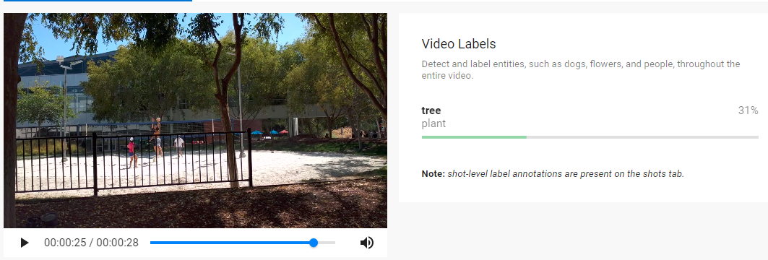
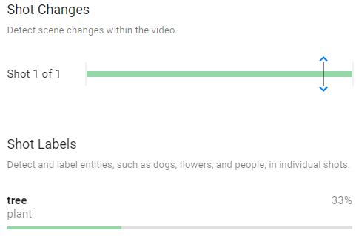
16. Google Cognitive Services: Cloud Video Intelligence
Video name: volleyball court
Only tree was recognized.
Labels can not change with frame.

Slide 44
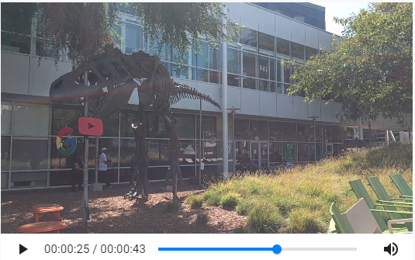
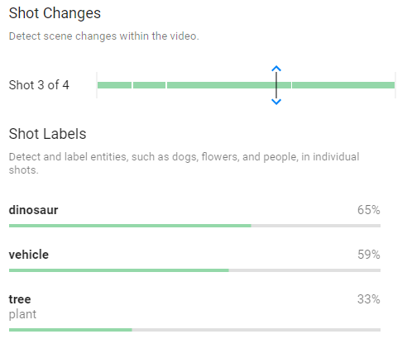
16. Google Cognitive Services: Cloud Video Intelligence
Video name: gbikes_dinosaur
Labels changes with shot.

Slide 45


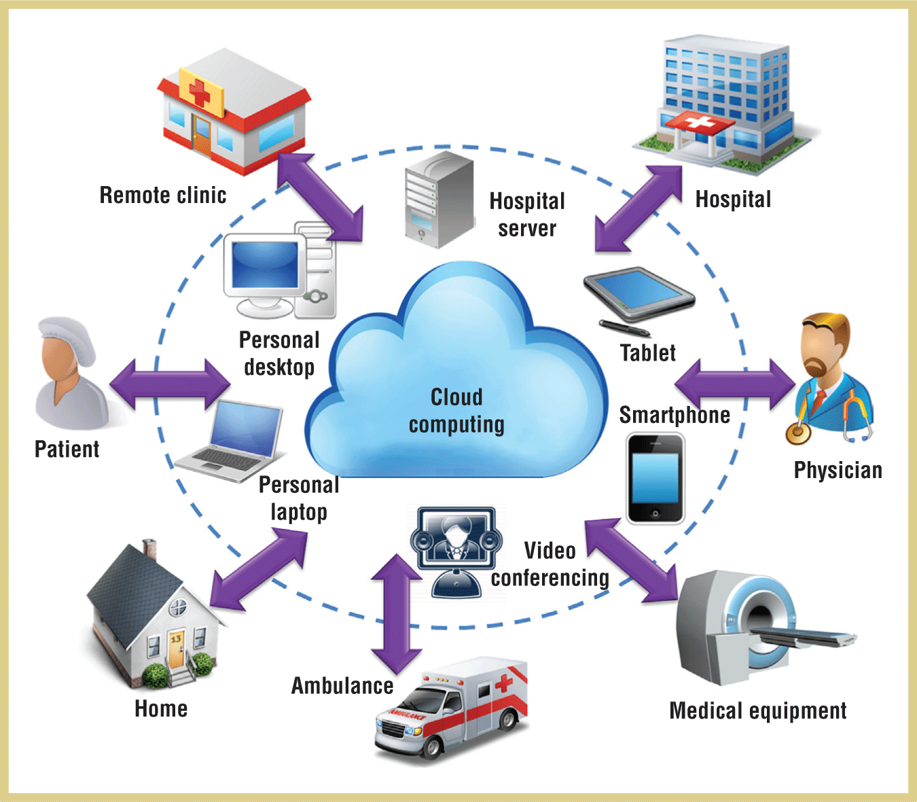

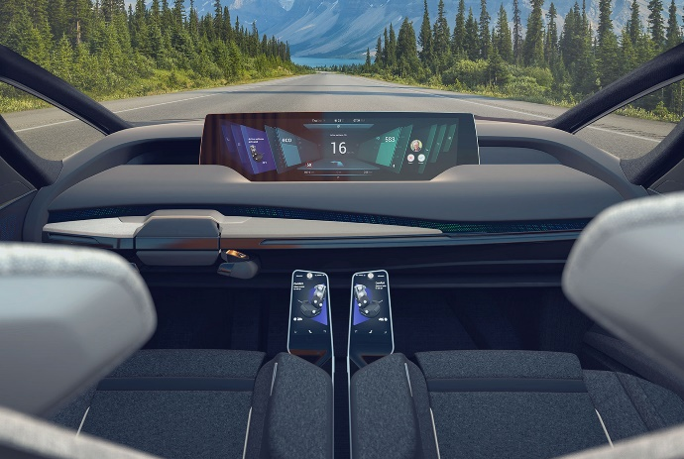

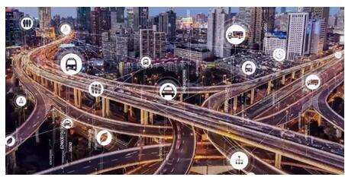
Future Applications
Health
Education
Work
Vehicle
Transport
Life

Slide 46



Future Applications-Education
Say goodbye to classroom teaching
Always-On experiences
Virtual Reality (VR) and Augmented Reality (AR) for teaching
Wearables and location-awareness solutions
IoT spreading across the institution
Multiplication of dense environments

Slide 47
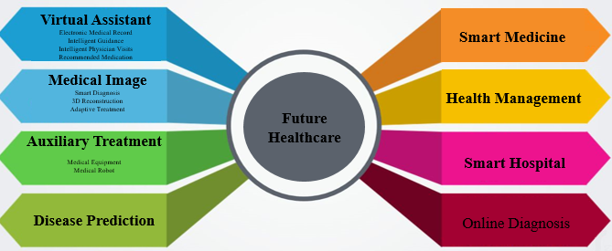


Future Applications - Health
Vehicle

Slide 48
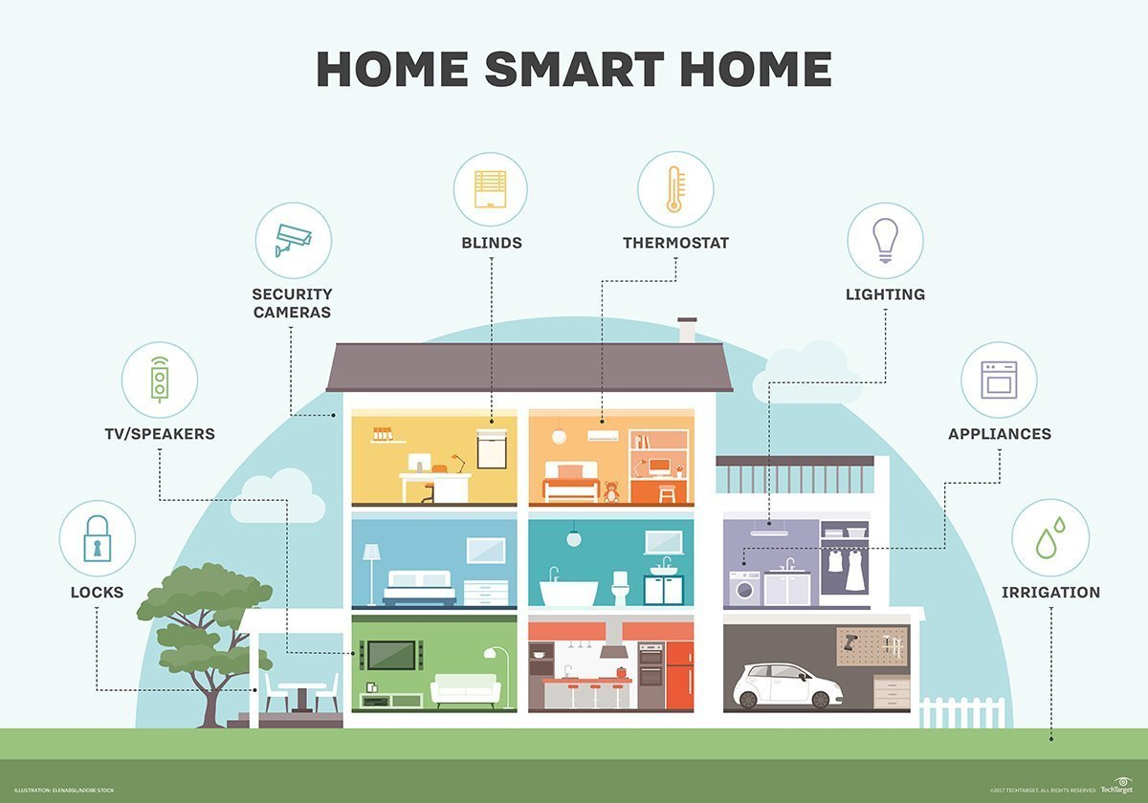
Future Applications - Life
Vehicle

Slide 49

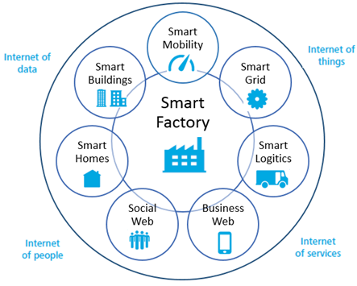

Future Applications - Work
Seamless digital networks
Virtual planning of products
Production and remote maintenance
Decentralised control of production
Integration of IT systems and analytics
Vehicle

Slide 50


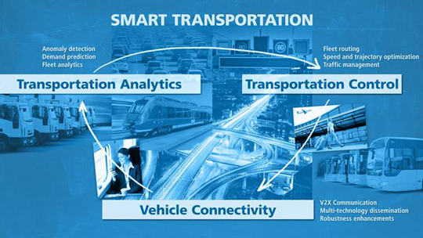


Future Applications - Transport
Vehicle

Slide 51
Conclusions
The technical application of cognitive services is mainly in the following aspects:
Natural language processing (including speech and semantic recognition, automatic translation)
Computer vision (image recognition)
Knowledge representation
Automatic reasoning (including planning and decision making)
Machine learning
Robotics

Slide 52
Conclusions
Cognitive services provided by IBM Watson have simple function and fast running speed.
Microsoft products are good at the analysis of speech, vision, natural language.
Google Cognitive Services are multifunctional, supports multiple languages, but some functions run slower.
Deep learning and big data play important roles in the development of cognitive services.
The development of cognitive services will greatly facilitate our lives.
The protection of personal privacy is especially important.

Slide 53
Thanks for your attention!

